Slide 1

Progressive Web App

Slide 2
Websites Or Native Apps

Slide 4
80%
Of Time Spent In
USERS’ Top 3 Apps

Slide 5
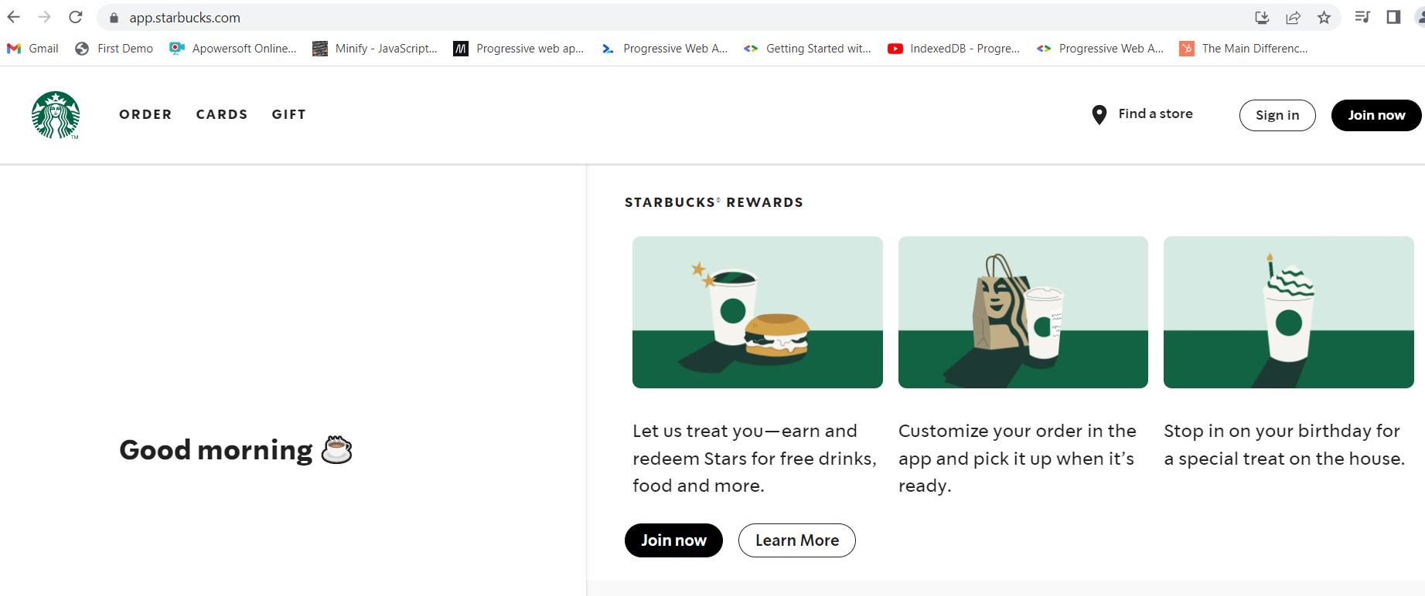

Slide 6
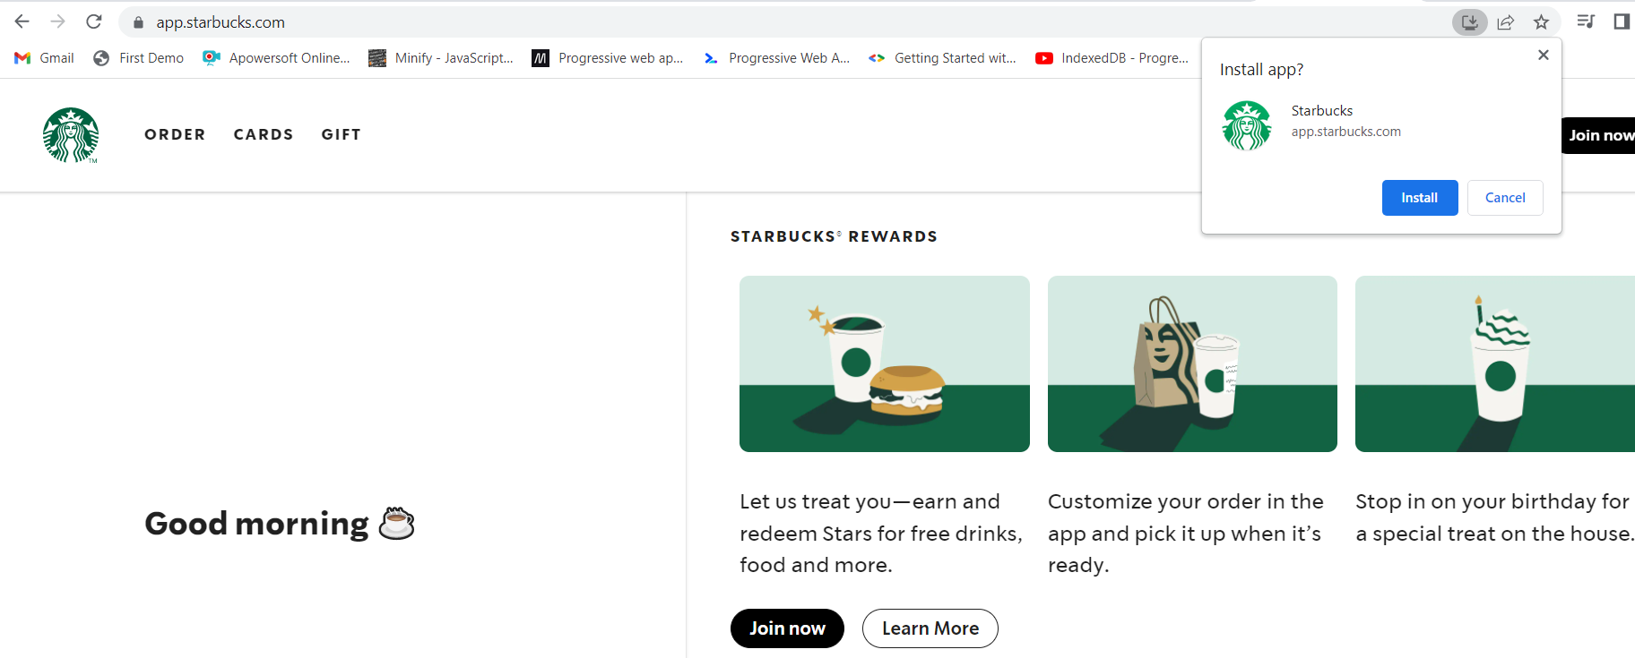

Slide 7
What was missing
Reliable Performance
Push Notification
Home screen icon metadata

Slide 8
40% of users bounce from sites that take longer than 3 seconds to load

Slide 9
What is Progressive Web Apps?
The term "Progressive Web App" isn't a formal or official name. It's just a shorthand used initially by Google for the concept of creating a flexible, adaptable app using only web technologies.
For example, web apps are more discoverable than native apps; it's a lot easier and faster to visit a website than to install an application, and you can also share web apps by sending a link.
On the other hand, native apps are better integrated with the operating system and therefore offer a more seamless experience for the users. You can install a native app so that it works offline, and users love tapping their icons to easily access their favorite apps, rather than navigating to it using a browser.

Slide 10
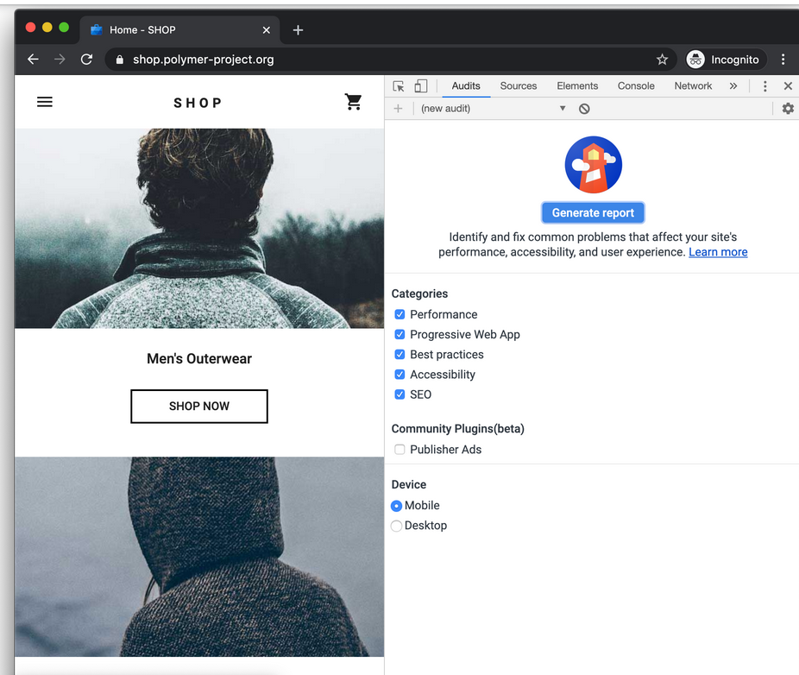

Slide 11


Slide 12
Architecture Of an App
There are two main, different approaches to rendering a website — on the server or on the client. They both have their advantages and disadvantages, and you can mix the two approaches to some degree.
Server-Side Rendering
Client-Side Rendering

Slide 13
What makes an App a PWA
Discoverable, so the contents can be found through search engines.
Installable, so it can be available on the device's home screen or app launcher.
Linkable, so you can share it by sending a URL.
Network independent, so it works offline or with a poor network connection.
Progressive, so it's still usable on a basic level on older browsers, but fully-functional on the latest ones.
Re-engageable, so it's able to send notifications whenever there's new content available.
Responsive, so it's usable on any device with a screen and a browser—mobile phones, tablets, laptops, TVs, refrigerators, etc.
Safe, so the connections between the user, the app, and your server are secured against any third parties trying to get access to sensitive data.

Slide 14

What are the technical components of PWA

Slide 15
Service Worker
A service worker is a type of web worker. It's essentially a JavaScript file that runs separately from the main browser thread, intercepting network requests, caching or retrieving resources from the cache, and delivering push messages.

Slide 16
HTTPS
Google Chrome makes it clear to a user when they visit an unsafe website. The address bar will display “Not secure” before the domain name, which tells users that their information is vulnerable to being stolen.
HTTPS is a pillar of a safe internet experience. It shows your customers you’re committed to security and that you care about their data and keeping it private.
An insecure website looks bad to customers, and it can hurt your search engine optimization (SEO) ranking in relevant searches.

Slide 17
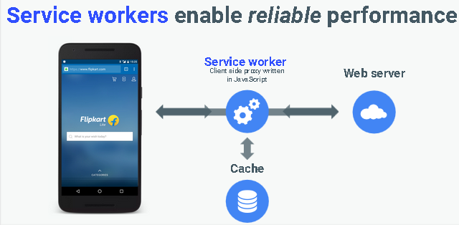

Slide 18
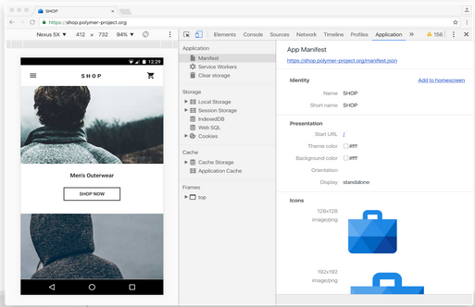

Slide 19
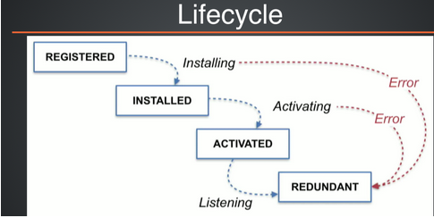
The Service Worker life cycle

Slide 20
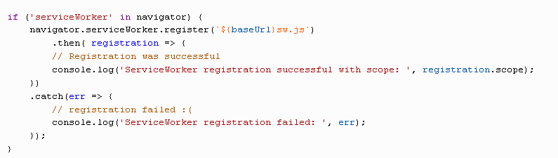
Register Service Worker

Slide 21
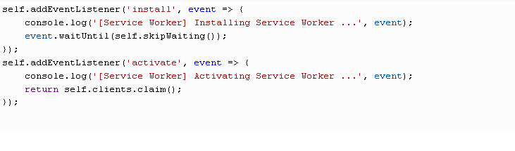
Install and Activate Service Worker

Slide 22
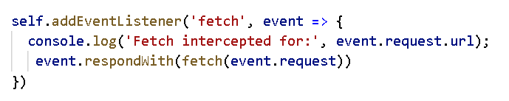
Fetch

Slide 23
Fetch API
the Fetch API, a simple interface for fetching resources, and an improvement over the XMLHttpRequest API.

Slide 24
Add to Home Screen Feature
Add to Home screen (or A2HS for short) is a feature available in modern browsers that allows a user to "install" a web app, ie. add a shortcut to their Home screen representing their favorite web app (or site) so they can subsequently access it with a single tap.

Slide 25
Activating the install prompt
Chrome 67 prompted users automatically, but starting in Chrome 68, the install prompt should be activated programmatically in response to a user gesture.
The beforeInstallPromptEvent is fired at the window.onbeforeinstallprompt handler before a user is prompt to “install” a web site to a home screen on mobile

Slide 26
Manifest File
The web app manifest is a JSON file that tells the browser about your Progressive Web App and how it should behave when installed on the user's desktop or mobile device. A typical manifest file includes the app name, the icons the app should use, and the URL that should be opened when the app is launched.
To generate manifest file you can use https://www.simicart.com/manifest-generator.html/

Slide 27
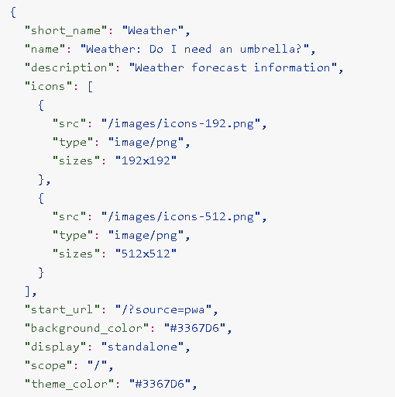

Slide 28
Working Offline using Cache API
The Cache interface provides a persistent storage mechanism for Request/Response objects pairs that are cached in long lived memory. How long a Cache object lives is browser dependent, but a single origin’s scripts can typically rely on the presence of a previously populated Cache object.

Slide 29
Assignment
Create your own button that enable you to implement add to home screen feature on any browser and bonus (test your feature on mobile).

